Slide 1
CS5590 Applied Programming Series
Programming for Web/Cloud based Application

Slide 2
GitHub
WebStorm

Slide 3
GitHub

Slide 4
Git Basic Tasks
1. Create Git remote repository using Git account
2. Clone Git repository to your local
3. Use Git to add file into local
4. Modify files and use Git to commit change
5. Use Git to push the commit to remote
6. Use Git to pull (sync) content with remote

Slide 5
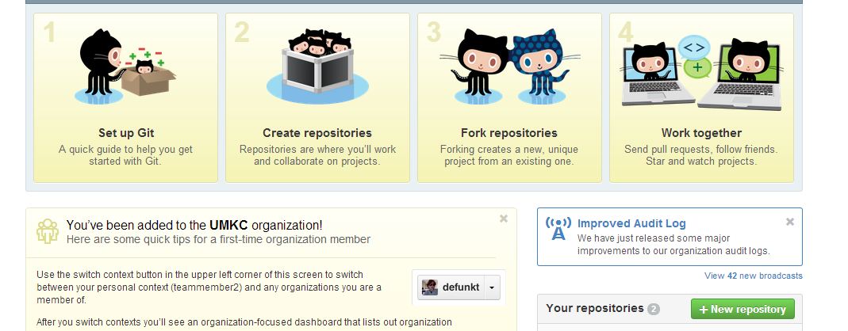
GitHub 1. Create Repository

Slide 6

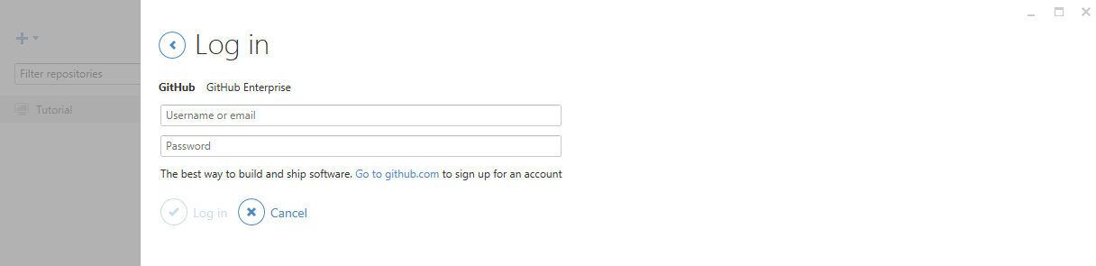
Git
For Windows user, please open GitHub desktop by double clicking icon
login to your GitHub desktop with your GitHub account (It is very important to login before you do the rest of steps. Because after you login, you secure connection has been made)

Slide 7
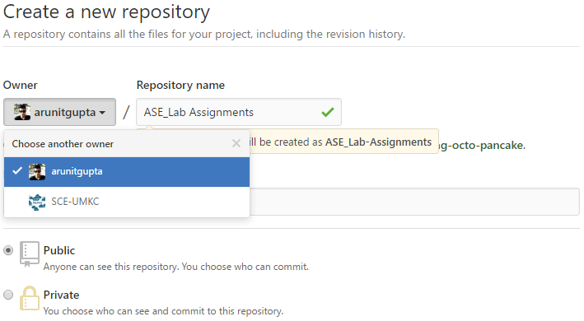
Git 1. Create Repository
We will add each group to our created organization “SCE-UMKC”.
Create your project under Owner SCE-UMKC, give a project name. That is the repository
If you are not the member of SCE-UMKC yet, you can just create a repository under your username

Slide 8
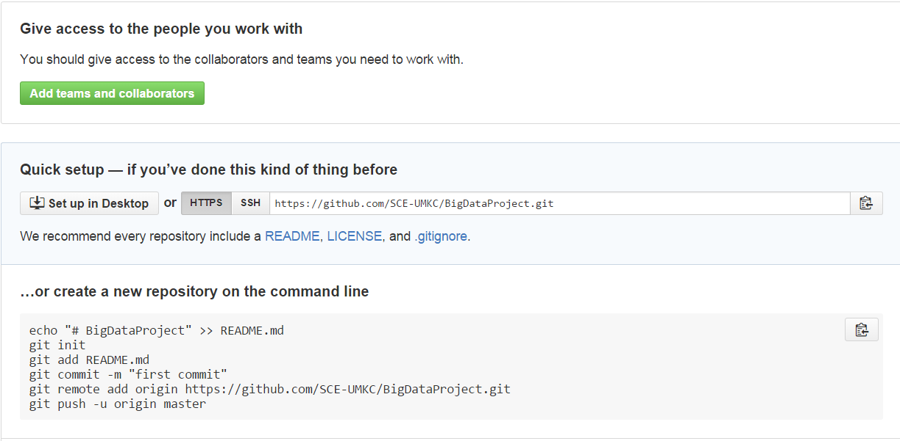
Git 2. Clone repository to your local
git clone https://github.com/xxxxxxx.git

Slide 9
Git
After clone, you will find a folder has the same name as repository
Use the following command to go inside the folder
cd <folder_name> (e.g., cd BigDataProject)

Slide 10
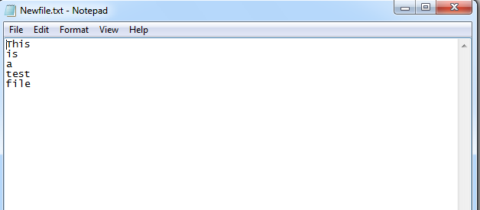
Git 3. Add file to local repository
In the local repository folder, we can add a new file
If you are a Linux or a Mac user
vi Newfile.txt
If you are a Windows user
echo This is a test file > Newfile.txt
If you add a file from local
git add Newfile.txt

Slide 11
Git 4. Commit this change
git commit –m ‘Someone committed on Sometime’
After commit, you can check git status to see if work directory clean
git status

Slide 12
Git 5. Push the change to remote
For Windows user, we first test if we are able to connect to GitHub
ssh -T git@github.com
https://help.github.com/articles/generating-ssh-keys

Slide 13
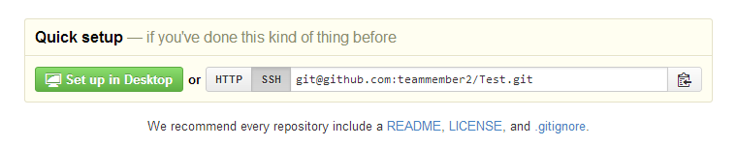
Git 5. Push the change to remote
Setup remote connection by SSH git address git remote set-url origin git@gxxxxxx.git

Slide 14
Git 5. Push the change to remote
Now you can push all to GitHub
git push --all

Slide 15
Git 6. Sync local with remote
If something change in remote, for sync purpose, you can type
git pull

Slide 16
For now, Windows users have done all basic steps.
But for Linux and Mac users, there are some more steps

Slide 17
Git 5. Push the change to remote (Non-Windows User)
For Linux or Mac user, we have more work to do before pushing change to remote
We have to setup SSH
Here are several steps

Slide 18
Git 5. Push the change to remote (Non-Windows User)
Generate a SSH key with your github email address
ssh-keygen -t rsa –C ‘your_email@example.com‘
It will ask you the file name to save this key and passphrase. Give the key name and make passphrase as empty.
For example, we give key name as id_rsa, key pair would be:
id_rsa and id_rsa.pub

Slide 19
Git 5. Push the change to remote (Non-Windows User)
(2) Add your new private key to the ssh-agent
ssh-agent -s
eval $(ssh-agent)
ssh-add Your_Key_Name

Slide 20
Git 5. Push the change to remote (Non-Windows User)
(3) Copy public key to your github account
vi Your_Key_Name.pub
Copy the content of this file

Slide 21
Git 5. Push the change to remote (Non-Windows User)
(4) Copy key to your GitHub account
In the user bar in the top-right corner of any page, click setting button
Click SSH Keys in the left sidebar.
Click Add SSH key.
In the Title field, add a descriptive label for key
Paste your key into the "Key" field.
Click Add key.

Slide 22
Git 5. Push the change to remote (Non-Windows User)
(5) SSH to github for testing ssh -T git@github.com

Slide 23
Git 5. Push the change to remote (Non-Windows User)
(6) Switching remote URLs from HTTPs to SSH git remote set-url origin git@gxxxxxx.git

Slide 24
Git 5. Push the change to remote (Non-Windows User)
(7) Now you can push
git push --all

Slide 25
Git 6. Sync local with remote (Non-Windows User)
If something change in remote, for sync purpose, you can type
git pull

Slide 26
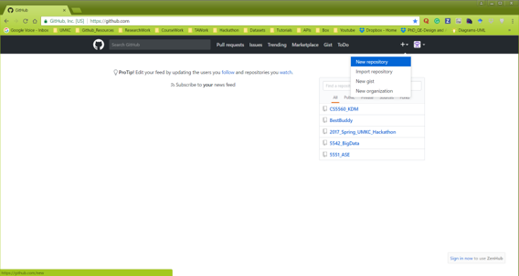
GitHub using GUI

Slide 27
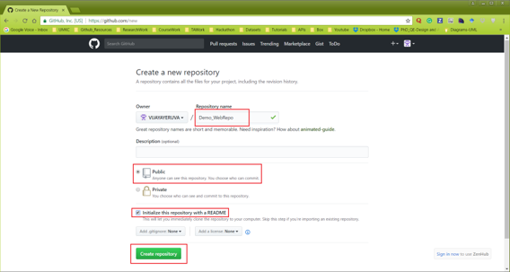
GitHub using GUI

Slide 28

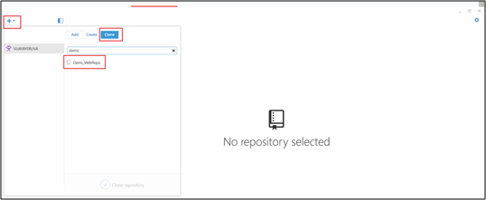
GitHub using GUI

Slide 29
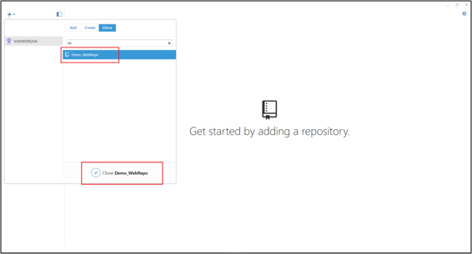
GitHub using GUI

Slide 30
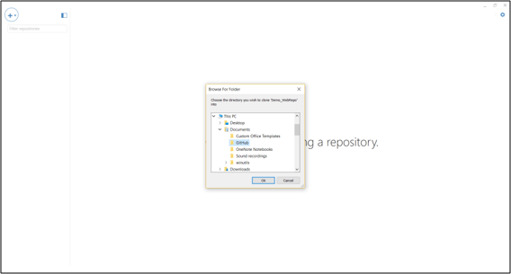
GitHub using GUI

Slide 31
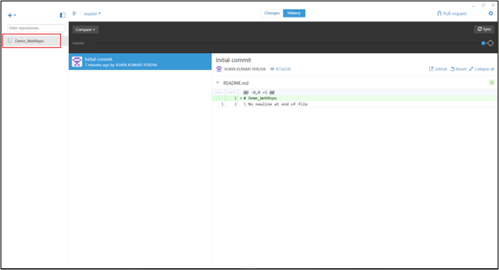
GitHub using GUI

Slide 32
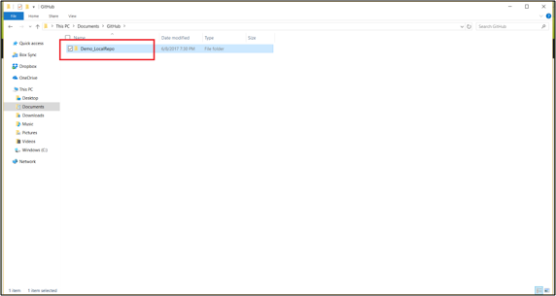
GitHub using GUI

Slide 33
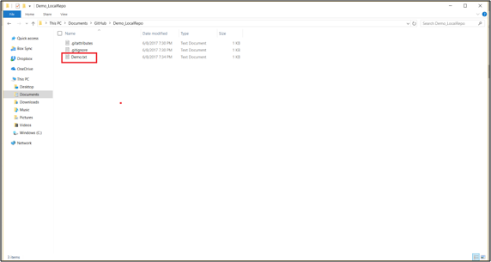
GitHub using GUI

Slide 34
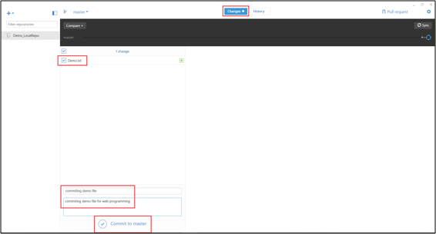
GitHub using GUI

Slide 35
Webstorm

Slide 36
Webstorm
IDE for web development
Can be downloaded from https://www.jetbrains.com/webstorm/
Don’t forget to register/login into JetBrains account with your UMKC outlook email id before downloading.

Slide 37
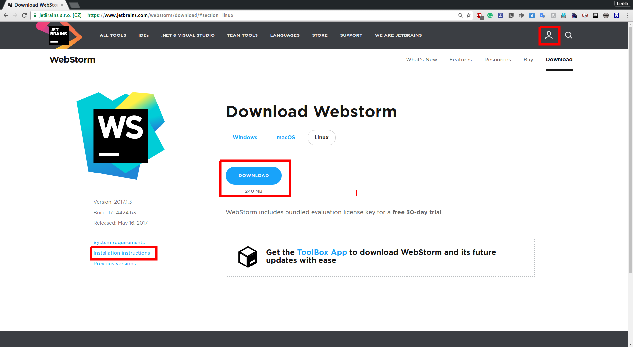
Download Webstorm

Slide 38
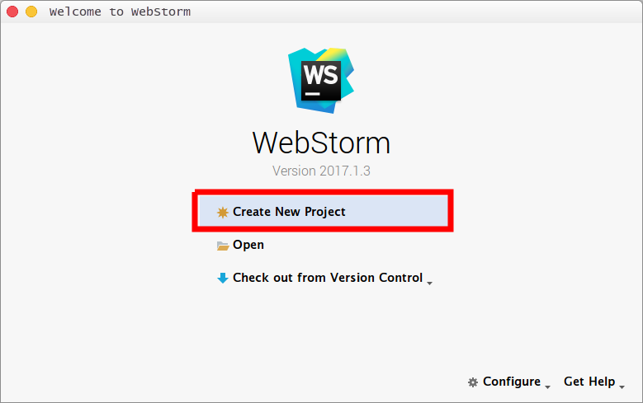
Create Project

Slide 39
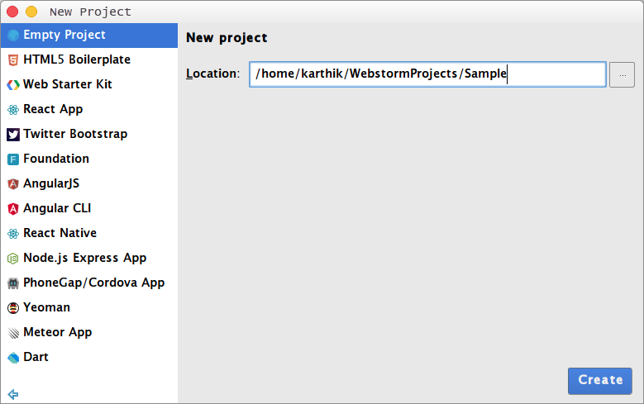
Create Project

